Slide 1




Why a gender approach is good for workers, business and the sector
CASE FROM THE ETHIOPIAN FLOWER SECTOR

Slide 2
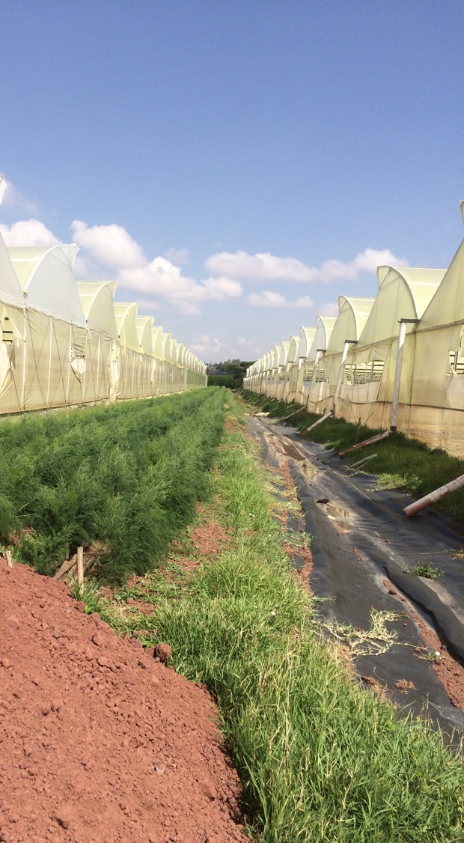




Gender equality in Ethiopian flower industry: the partners
Ethiopian Horticulture Producers and Exporters Association (EHPEA):
Represents Ethiopian flower farmers and exporters and supports more responsible production methods, promoting gender equality and fostering women empowerment programs.
Business for Social Responsibility (BSR):
With HERproject, BSR aims to empower low-income women working in global supply chains through workplace-based interventions on health, financial inclusion, and gender equality.
IDH, The Sustainable Trade Initiative:
IDH convenes companies, CSOs, governments and others in public-private partnerships with the aim of driving change through co-funding and prototyping of new economically viable approaches to realize green and inclusive growth at scale in commodity sectors and sourcing areas.
Floriculture Sustainability Initiative (FSI):
Market-driven initiative that brings the international floriculture supply-chain together to improve sustainability practices through field projects and increased transparency.
“The farms have understood that women are the altar of the business. Women play a critical role in the overall process of the farms’ production, so investing in these women with regard to gender empowerment is rewarding at all levels.”
EHPEA Project manager:

Slide 3






“Empowering the Source”
Gender Projects 1 and 2
Implemented by EHPEA and BSR HERproject, co-funded by IDH
on 26 &
42 farms…
…benefitting 7,000 & 20,000 workers
Gender interventions
Key activities
Costs
Challenges
2-level support:
Strengthening the workplace systems
Building capacities and supporting workers’ needs
Establishment of Gender Committee
Training of Farm Managers, Gender Committees and Workers
Review of HR policy – gender equality and sexual harassment
EHPEA Project 1 –
€ 18.88/worker & year
EHPEA Project 2 –
€ 9.20/worker & year
High staff turnover
Low awareness about gender & women’s rights

Slide 4

Trends in the sector and in market expectations
Markets and standards requirements
Expected business benefits of gender interventions are:
  Improving worker engagement
  Maintaining a committed and stable workforce
  Decrease absenteeism
  Increasing labor productivity
  Ensuring compliance with health and safety requirements
Source: Business for Social Responsibility - BSR
Intrinsic motivation of flower companies
NGOs pressuring for human rights and decent work
Growing evidence from all sectors that investing in gender-sensitive policies and practices makes business sense

Slide 5
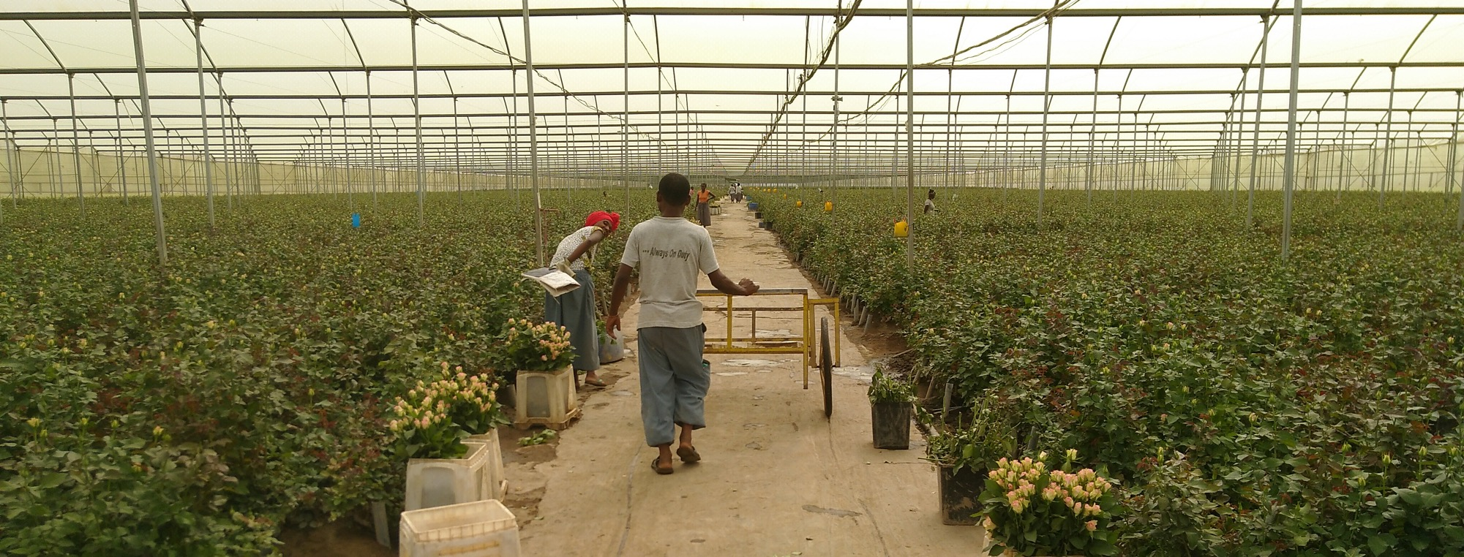
Do we have evidence?
Gender interventions (e.g. Inclusive policies and practices)
Increased workers’ satisfaction and engagement
Change of workers attitudes, behavior and motivation at workplace
Improved business performance of flower farms

Slide 6

Analysis of business case
Conducted by Fair & Sustainable Consulting, funded by IDH and supported by FSI, BSR and EHPEA
Interviews and Focus Group Discussions:
Debre Zeit (50km)
4. Minave Flower farm
5. Joytech Farm
with workers, management, gender committees, unions and medical staff
180 respondents, 67% female
Five farms selected out of 42, with following farm selection criteria:
Koka town (95km)
3. Dummen Farm
Best performing on gender interventions, reporting and achievements
Gender committee establishment
Workplace policies, reporting and records in place
Diversity in: ownership (national /international), products, markets, big / small
Ziway (163km)
1. Sher Ethiopia
2. AQ Roses
Analysis of:
Costs and Benefits
Relationship between gender interventions & business indicators
FARMS SELECTED | Sher Ethiopia | AQ Roses P.L.C | Minaye Flowers P.L.C | Joytech P.L.C | Dümmen Orange

Slide 7
5 Most Significant Changes and Causes
Mentioned by workers, gender committees and (operational) managers of the 5 selected farms, during 30 Focus groups discussions
 | Most Significant Changes | By % of focus groups | Causes
 | Right of young mothers for at least one-hour breastfeeding time per day | 50% | Requested by Union and workers Decided by farm management to improve workers’ satisfaction and to reduce turnover
 | Increased awareness on gender sexual harassment, reproductive health, contraceptives and safety | 47% | Gender committee (GC) established (by IDH/EHPEA/BSR project) Awareness raising and training by GC, NGO’s, Bureau of Labor and social affairs Zero-tolerance: severe punishment by farm
 | Maternity leave increased from 3 to 4 months | 40% | Requested and negotiated by workers’ union, gender committee and certifiers
 | Reduction of reported cases of gender based violence, after a first rise | 37% | Raised awareness about GBV and women rights (IDH/EHPEA/BSR project) Increased confidence of women due to GC support Clear HR policy and enforcement by farm (IDH/EHPEA/BSR project) Corporate leadership/positive attitude towards gender equality, due to EHPEA training, standards’ requirements, and intrinsic motivation
 | Increased self-confidence of women, and improved negotiation skills | 37% | GC’s awareness raising and trainings on gender and worker’s rights (by IDH/EHPEA/BSR and others)
1
Female workers:
“Before, female workers were too shy to talk about sexual harassment or to report GBV cases and ask questions about family planning, but nowadays we do”.
“Moreover, we see that our gender committee and union nowadays negotiate for the need for resting places and day care facilities for mothers”.
2
3
4
5

Slide 8
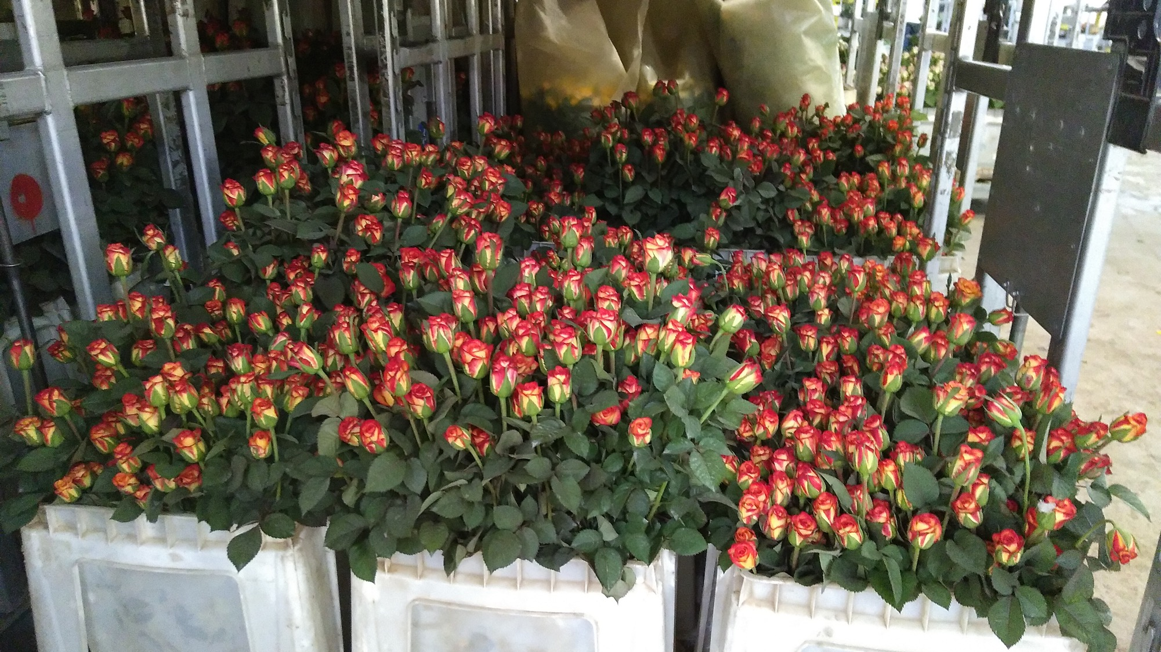
Quotes
Operational manager:
“The culture is changing: despite the fact that the husband of one of our workers wanted his wife to stay home and manage a coffeehouse, she decided to remain working in our flower company and make her own money.”
Female workers:
“The training on time management improved our personal life. I am much more organized and time sensitive now than before I took the training. We are trained on the advantages of saving and planning; this is what I have also told my mother...”
”Since we know much more about family planning and provision of contraceptives, we can discuss family planning with our husbands.”
Member of Gender Committee:
“We are satisfied with the functioning of our Gender Committee. We have recognition from the management and also among workers. We have made an action plan for 2018 which is more focused on trainings for new workers and refreshment trainings. However, we are not implementing it, due to current budget and time constraints.“

Slide 9
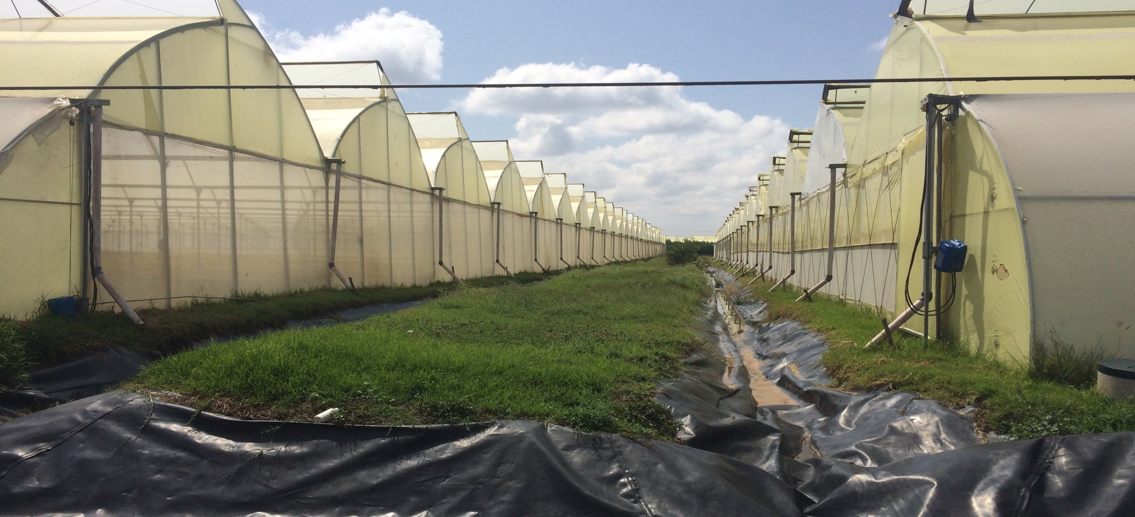
Good gender and labor practices on selected farms
Resulted in:
Respectful, caring and concerned management attitude towards the worker’s lives and work situation
Mixed gender committee, annual plan, regular trainings, guest speakers, engagement in social activities
Detailed information on gender committee on posters at workplace
Gender trainings & events included in company calendar
Large, clean and well lit packing house, with music
Milk powder for pregnant women
Adjusted working hours for workers couples with children
Fair trade premium supports training of workers on different topics to earn extra income outside the farm
  Positive & respectful workplace atmosphere and highly motivated workers
  Gender Committee visible, well known and widely recognized
  Interventions of Gender committee are more effective
  Better perceived gender committee and management, improved relationships
  Well organized and efficient work place conditions
  Healthier and more engaged workers with an improved work-life balance
  Workers get increased skills, confidence and income from non-farm activities
Farm owner:
“…if people are respected, they will do their best and this results in good flowers. If not respected, they do not produce well, and the company will not perform. So, it is a must to treat the workers respectfully.”

Slide 10
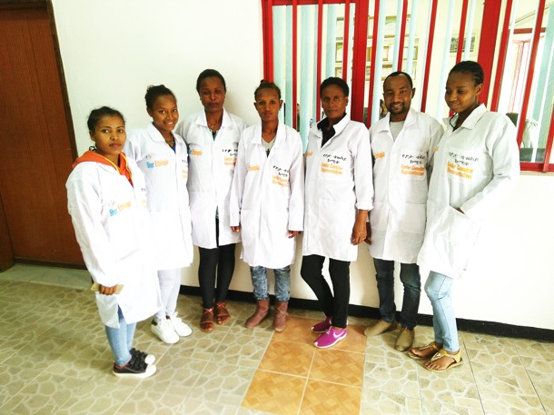
Effects of gender interventions of the project
Workers:
“Workers now have increased awareness on gender, sexual harassment, reproductive health and safety. We learned which actions and behavior are ‘normal’, and not normal, while before workers did not know. We are now aware of the codes of conduct and how to behave in the work place and about the punishment. And that we can report to the gender committee.”
Gender committee at SHER farm
Farm owners & managers:
“The gender investments pay off: we see gender interventions as rational and necessary for us to stay in business, not in the last place because the majority (up to 80%) of our workers is female.”
Improved relationship among workers/with management
32% decrease of gender-based violence cases (2015-2017)
More satisfied and motivated workers
More healthy workers
40% more women in management positions (2013-2017)

Slide 11
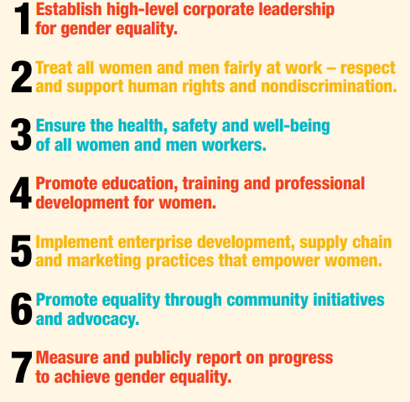
What can the sector do?
What farms can do:
Owners paying positive and regular attention to workers
Further improvement gender sensitive policies + practices
Promote a mixed female/male composition of gender committees
Wider bonus opportunities for female workers
Establish day care facilities
Communication about Integrated Pest Management
Drinking water access
Endorse and use the
UN Women’s Empowerment Principles (WEPs 1-7) as guide for action
What supporting organizations can do:
Organize/promote exchange (visits) and learning between farms
Develop sector strategy to communicate about Integrated Pest Management
Develop sector wide sex-disaggregated data collection and reporting framework

