Slide 1
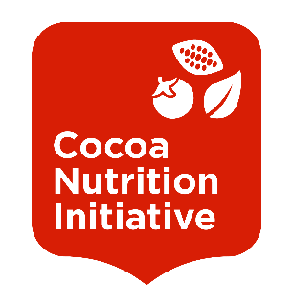
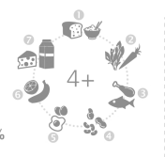


Cocoa Nutrition Initiative
An Initiative of the IDH Cocoa Learning and Innovation Program (CLIP)
FOOD SECURITY & NUTRITION
Smallholder farmers are estimated to spend over 50% of their income on food. Almost all cocoa produced in Cote d’Ivoire and Ghana (which together supply over 60% of the world’s cocoa) is supplied by smallholder farmers whose primary income comes from cocoa. Risks of food insecurity occur when cash runs out just before the main cocoa season and food prices rise.
In addition to the challenges around the availability and affordability of food during certain periods is the absence of diet diversity throughout the year leading to chronic malnutrition. Up to 30% of children growing up in cocoa communities have impaired development due to malnutrition and almost half of the adult women in these communities suffer from iron deficiency anemia. The short and long term effects of malnutrition include:
BUSINESS CASE
The potential benefits of improved nutrition for farmers and companies include:
INDUSTRY COMMITMENT
Commit to design and test models with cocoa farming communities and technical partners
Commit to integrate tested models and tools into standard business practice
Contribute to shared learning and innovation for scaled impact
↗ Farmer health
↗ Farm Productivity
↗ Diversified Income
↗ Future Supply
↗ Loyalty
↗ Reputation
INTEGRATED APPROACH
Promoting a better understanding and response to food and nutrition security is in the interest of the entire cocoa supply chain. This requires an integrated livelihoods approach and public-private partnerships to jointly innovate effective models that can have impact and be scaled up.
↘ PRODUCTIVITY
↘ INCOME
↘ ECONOMIC RESILIENCE
↗ FATIGUE
↘ HEALTH
↘ CHILD DEVELOPMENT
2020 VISION
A thriving cocoa sector enables entrepreneurial cocoa farmers to run profitable cocoa farms and to invest in the future of their farms, families and communities. Better nourished cocoa communities are healthier, more productive and provide a more attractive prospect for the next generation of cocoa producers.
By the end of 2020, the Cocoa Nutrition Initiative will have tested models with the potential to be integrated by cocoa companies into standard business practice, with the potential to affect 100,000 people in cocoa farming communities in Cote d’Ivoire and Ghana.
Food & Nutrition Security
Increased Knowledge
Increased Diversified Production
Increased Women’s Empowerment
Increased Household Income
DIET quality
Water &
Sanitation
Early Childhood
Nutrition
Cocoa nutrition innovation programs
To design and test effective models that improve food and nutrition security of cocoa farming families
&
cocoa nutrition LEARNING PLATFORM
To scale integration of food and nutrition
security in cocoa industry business models

Slide 2
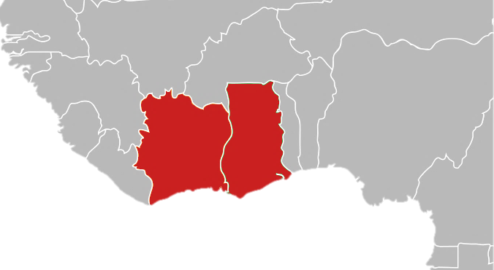









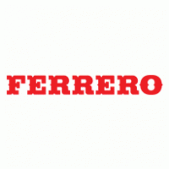

Learning and Innovation
&
DeSIGN AND TEST effective models that improve FOOD AND nutrition SECURITY of Cocoa Farming families
Learning Agenda for SCALING INTEGRATION Of food and nutrition IN COCOA INDUSTRY BUSINESS MODELS
1
Phase 1: Participatory Scoping
2016-2017
Collectively improve understanding of malnutrition in cocoa producing communities in Ghana and Cote d’Ivoire
LEARNING AGENDA
Our learning agenda is guided by our integrated livelihoods approach which draws from project learnings on (i) behavior change and (ii) business model integration.
We examine the extent to which behavior change is facilitated by a combination of:
Increased knowledge on nutritious practices
Increased income
Increased women’s empowerment
Increased diversified production (crop and livestock)
We examine the extent to which business model integration is influenced by company capacity, resources and commitment as well as service delivery model structure.
✓
2
Phase 2: Identification and Design
2017-2018
Companies in Ghana are guided by GAIN to identify opportunities to improve diets through its supply chain.
Prototype models are developed with a thorough monitoring and evaluation plan for nutrition outcomes, iterative learning, and an explicit intention and potential for scale if the prototypes prove successful
✓
3
Phase 3: Adaptation and Validation
2018-2019
Prototype models are implemented in Ghana in two stages: During the first adaptation stage components of the prototypes (such as training curricula) are developed and individually tested with target groups. During the second validation stage the prototypes selected by businesses are regularly tested and improved through a quality improvement process.
Based on learnings from Ghana, companies in Cote d’Ivoire are guided by IDH to identify opportunities to improve food and nutrition security through its supply chain.
LEARNING EVENTS
✓
Quarterly country level learning workshops with partners prototyping models
Regional learning events for cross-learning
Annual Multi-Stakeholder events to promote the scaling of effective models that integrate food and nutrition security in the cocoa supply chain
COCOA NUTRITION LEARNING PLATFORM
GHANA & CÔTE D’IVOIRE
PARTNERS
4
Phase 4: Sharing, Scaling and Continued Learning
2019-2020
Effective models are scaled by the private sector partners through integration in standard business practice.
The Cocoa Nutrition Learning Platform regularly convenes industry, government and technical partners to share lessons and tested tools with the aim of scaling effective models.

